Slide 1

DEPARTMENT OF ARTIFICIAL INTELLIGENCE AND DATA SCIENCE ACADEMIC YEAR 2025 - 2026 SEMESTER III ARTIFICIAL INTELLIGENCE LABORATORY MINI PROJECT REVIEW Snake and Ladder Solver using BFS
REGISTER NUMBER | 211724007006
NAME | ABINAYA S
YEAR | 2
SECTION | A
FACULTY IN-CHARGE | Mrs. M. Divya

Slide 2
PROBLEM STATEMENT
AI Overview: AI enables machines to think, learn, and solve problems intelligently.
Topic: The Snake and Ladder game can be viewed as a path-finding problem.
Challenge: Finding the shortest route to the end is complex
due to snakes (setbacks) and ladders (boosts).
Why It Matters: Demonstrates how AI algorithms solve real-world optimization problems.
Aim: Use BFS to find the minimum number of dice throws to reach the final cell.
Expected Result: Minimum dice throws and path sequence to win the game.

Slide 3
THEORETICAL BACKGROUND
The Snake and Ladder game is treated as a graph problem, where each cell is a node and dice rolls are edges.
BFS (Breadth-First Search) explores all possible moves level by level to find the shortest path.
Literature Survey: BFS is widely used in path-finding and board game AI. Other methods include DFS, Dijkstra’s, and Dynamic Programming.
Justification: BFS guarantees minimum moves, avoids repetition, and gives an optimal solution efficiently.
Example: Ladder 3→22 and Snake 17→4 — BFS traces the fastest route from cell 1 to 100.

Slide 4
IMPLEMENTATION AND CODE
Link to code in Git-hub Repository
List | Git-hub Repository Links
Implementation of Code Link | snake-ladder-BFS/snake_ladder_gui.py at main · abinaya22086/snake-ladder-BFS
Word Document Report Link | snake-ladder-BFS/report.docx at main · abinaya22086/snake-ladder-BFS
PPT Link | snake-ladder-BFS/project ppt.pptx at main · abinaya22086/snake-ladder-BFS

Slide 5
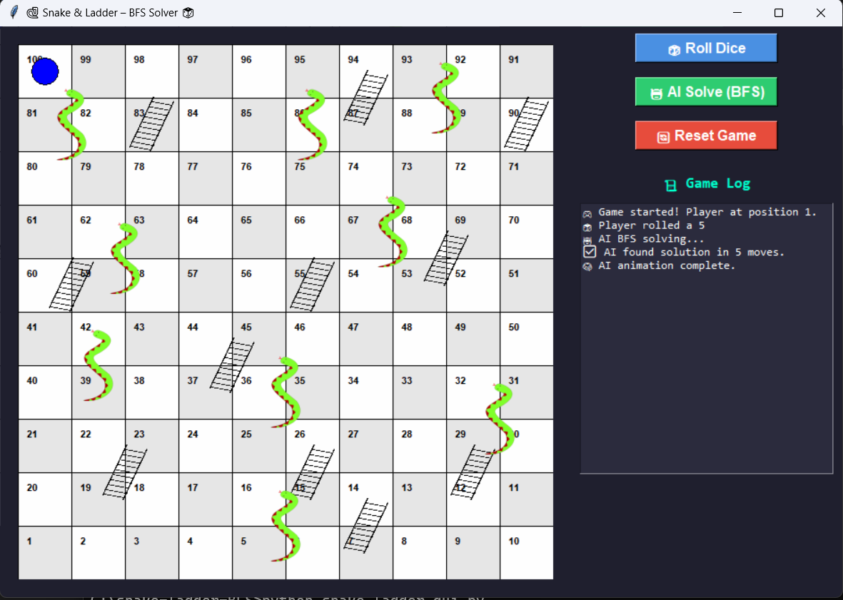
OUTPUT AND RESULTS
✅ Output:
Minimum Dice Throws: 5
AI Path Example: [1, 38, 44, 67, 84, 100]
💡 Explanation : The BFS algorithm quickly finds the optimal route by exploring all dice possibilities level by level. It reaches the final cell in just 5 moves by efficiently using ladders and avoiding snake traps.

Slide 6
OUTPUT AND RESULTS
Results:
BFS successfully finds the optimal path on the Snake and Ladder board.
Guarantees minimum dice throws compared to brute-force methods.
Future Enhancements:
Add an interactive GUI for real-time play and visualization.
Support custom board sizes and advanced snake/ladder layouts.
Introduce probability-based AI for smarter move prediction.

Slide 7
REFERENCES
Russell, S., & Norvig, P. Artificial Intelligence: A Modern Approach, 4th Ed., Pearson, 2020.
Cormen, T. et al. Introduction to Algorithms, MIT Press, 2009.
GeeksforGeeks: Breadth-First Search (BFS)
TutorialsPoint: Python BFS Algorithm
Stack Overflow Discussions: Snake & Ladder BFS Solver

